Slide 1
Improving Random Feedback Alignment with Transfer Learning
Gabi Kim, Andrej Kukuruzovic, Joshua Loong

Slide 2
Hypothesis
Initializing Random Feedback Alignment with weights gained through transfer learning could yield a more biologically plausible method that can improve performance.
Notes:
Gabi

Slide 3
Recap of initial plan
Train a network
Transfer Weights
Test RFA & Backprop with transferred weights on new dataset
MNIST (initial)
EMNIST
CIFAR-10
Notes:
Gabi

Slide 4
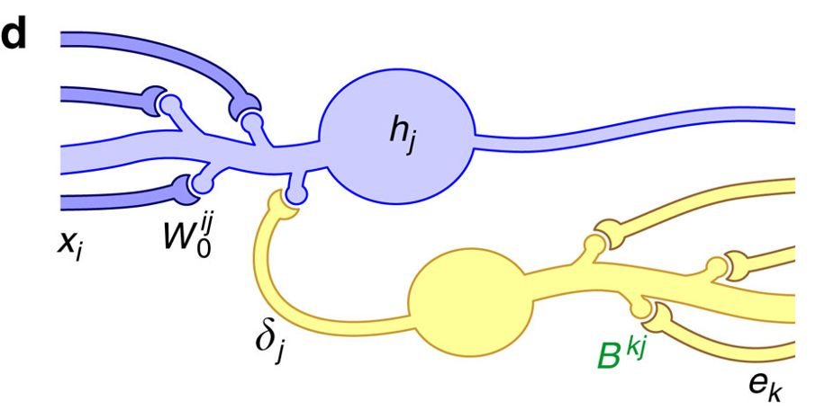
Biological Background
Weight transport problem:
Backprop needs rapid, symmetric backward weight transfer along the axon of a neuron but this is not observed
“Whilst the brain does exhibit widespread reciprocal connectivity that would be consistent with the transfer of error information across layers, it is not believed to exhibit such precise patterns of reciprocal connectivity”
Notes:
Backprop has been an amazing invention over the last few years
Used in all types of applications
Initially inspired by how neurons work in the brain but many neuroscientists have raised issue with how plausible it is
If we start ot rethink backprop maybe we can find more efficient and robust alternatives

Slide 5
Biological Background
Transfer learning has a lot of momentum in machine learning, but came from biological principles:
We can observe that organisms presented with new stimuli that have features of other stimuli they have seen, and they can group them within that category
At a higher-level, humans learning multiple tasks can use that to learn new ones

Slide 6
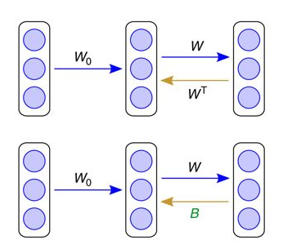
Mathematical Background
Backprop
δ = W^{T}e
RFA
δ = Be
We want the teaching signal to be within 90º of the signal used in Backprop

Slide 7
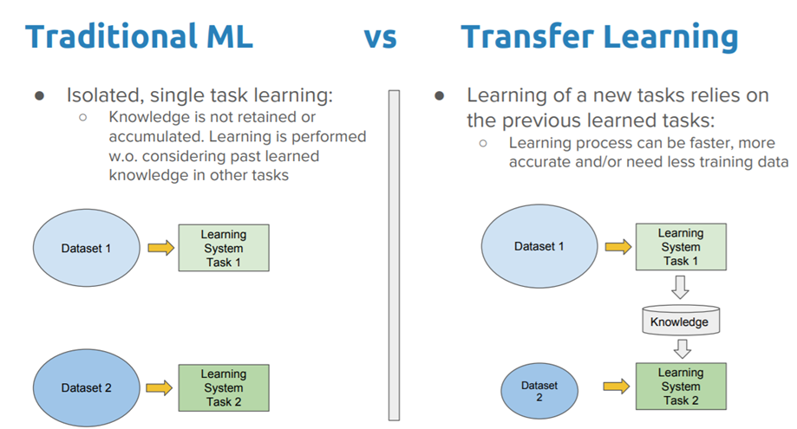
Transfer Learning

Slide 8
Our Method
We realized that randomly initializing over the weights of an old network may cause us to lose information.
The point of transfer learning is to retain useful information across models. We would ideally want our random feedback matrix to be initialized in a way that retains information of our old network.
Notes:
Josh

Slide 9
Our Method
Take the weight matrix in the final layer of our pre-trained network
Decompose this matrix into a lower dimensional space that captures the variance of these weights (using PCA)
Initialize a random distribution on this space
Use our PCA model parameters to transform this distribution into a semi-random matrix that ideally captures some of the information we want to transfer
Notes:
Josh

Slide 10
Project Map
Initial training and weight/error data download on MNIST
Created simulator to measure “angles” between old RFA and iterate on our new methods
These methods implemented in a customized version of RFA
Transferred weights used to train EMNIST for both:
Backprop
New RFA
Original RFA
Notes:
Gabi

Slide 11
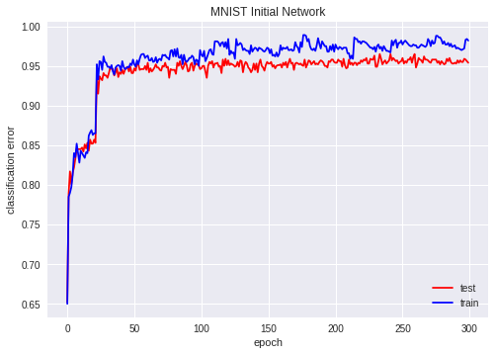
Initial Network Training (Backprop)
Notes:
Andrej

Slide 12
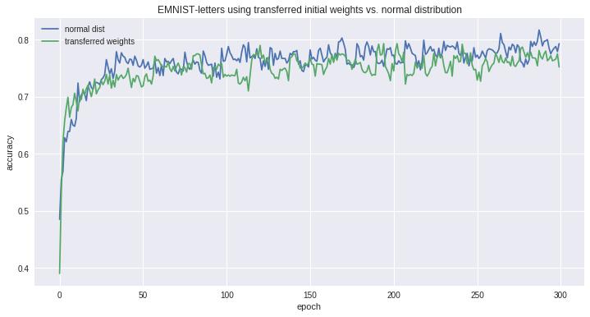
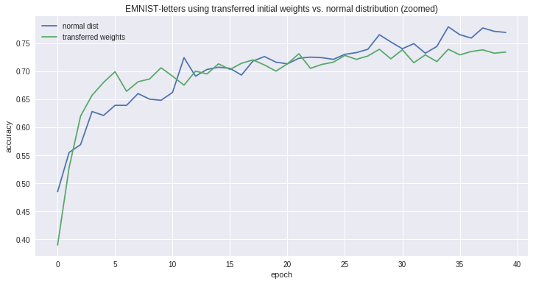
Backprop (26 letters)
Notes:
-Settled a little lower than 80% accuracy...maybe network is not strong enough to classify 26 different letters??

Slide 13
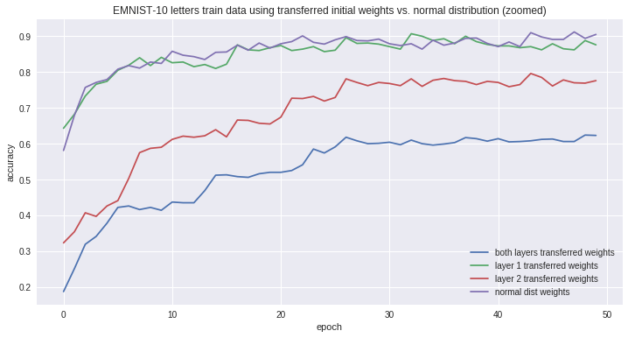
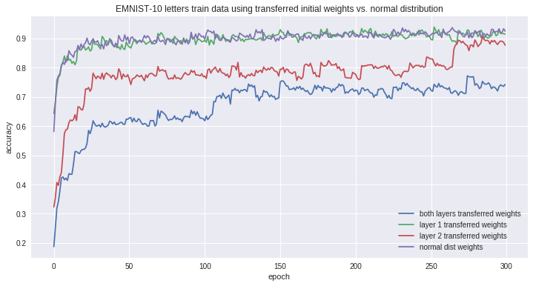
Backprop (10 letters)

Slide 14
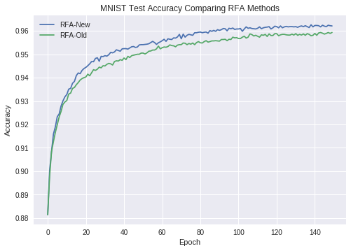
Custom RFA vs Original RFA - MNIST

Slide 15
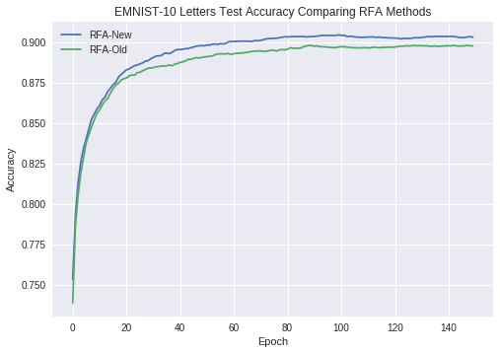
Custom RFA vs Original RFA - EMNIST

Slide 16
What went wrong
Losing information through random initialization in RFA caused us to change our method
The number of output weights changes from dataset to dataset, which is inconsistent with how we’ve implemented our new RFA
Notes:
Andrej

Slide 17
Next Steps
Apply this method to another dataset
Try using a pre-trained model
Experiment with better representations of initial weights in the latent space
Notes:
Gabi

Slide 18
References
Crick, F. (1989). The recent excitement about neural networks. Nature, 337(6203), 129-132.
Giurfa, M. (2008). Behavioral and Neural Analysis of Associate Learning in the Honeybee. Learning and Memory: A Comprehensive Reference, 561–585. doi:10.1016/b978-012370509-9.00067-x
Lillicrap, T. P., Cownden, D., Tweed, D. B., & Akerman, C. J. (2016). Random synaptic feedback weights support error backpropagation for deep learning. Nature communications, 7, 13276
Pradier, M. F., Pan, W., Yao, J., Ghosh, S., & Doshi-Velez, F. (2018). Latent Projection BNNs: Avoiding weight-space pathologies by learning latent representations of neural network weights. arXiv preprint arXiv:1811.07006.
Sarkar, D. (2018). A Comprehensive Hands-on Guide to Transfer Learning with Real-World Applications in Deep Learning [Blog Post]. Retrieved from https://towardsdatascience.com/a-comprehensive-hands-on-guide-to-transfer-learning-with-real-world-applications-in-deep-learning-212bf3b2f27a

Slide 19
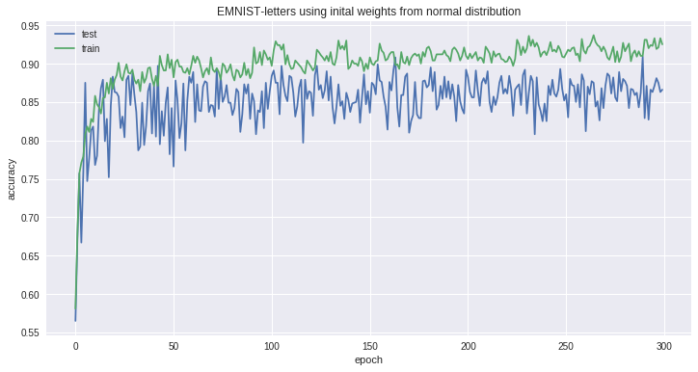
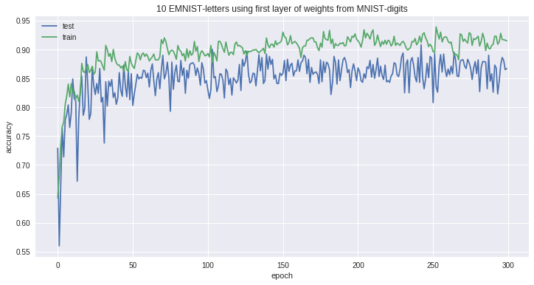
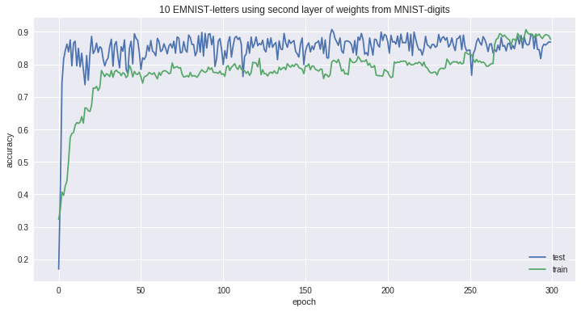
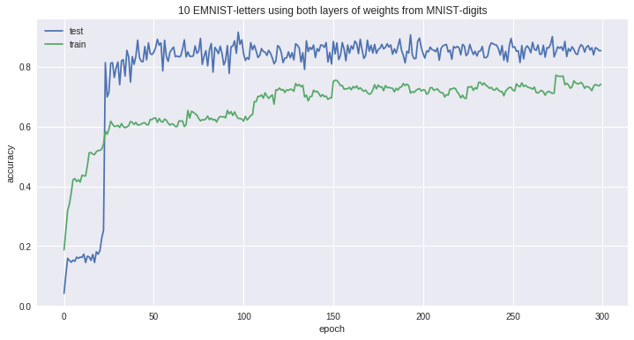
Appendix
Notes:
1: normal
2: w1
3: w2
4: w1 + w2

